Slide 1

Photo Gallery
Version 1.0

Slide 2


Institute Of Engineering & Management
Develop By :- Manish Kumar Gupta
Branch :- CSE
Section :- B
Year :- 4th Year
Semester :- 7th semester
University Roll No. :- 10400113141

Slide 3
Overview
Abstract
Introduction
System Requirement
Platform Use
DFD
Screen Short
Conclusion & Future Work

Slide 4
Abstract
This project is all about an online registration system of the customers who visit this webpage. So here any customer can login if they create an account here & they can also check out different aspects.
If they are interested, then they can fill-in the provided form & get registered.

Slide 5
Introduction
The main purpose of a photo gallery is to link other web sites by categorizing them into different sections. Sort of like an online filling cabinet, but the sites do not necessarily have to be in alphabetical order, but majority of web directories have their categories and topics in alphabetical order, but it is not a must.
The software is for online registration of any customer.

Slide 6
System Requirements
Hardware Requirements
Ram 1GB
Monitor
Keyboard.
Software Requirements
Windows 7, 8, 10.
Visual Studio 2012.
Chrome Browser.

Slide 7
Platform Used
Font End
ASP Dot Net
Back End
SQL Server

Slide 8
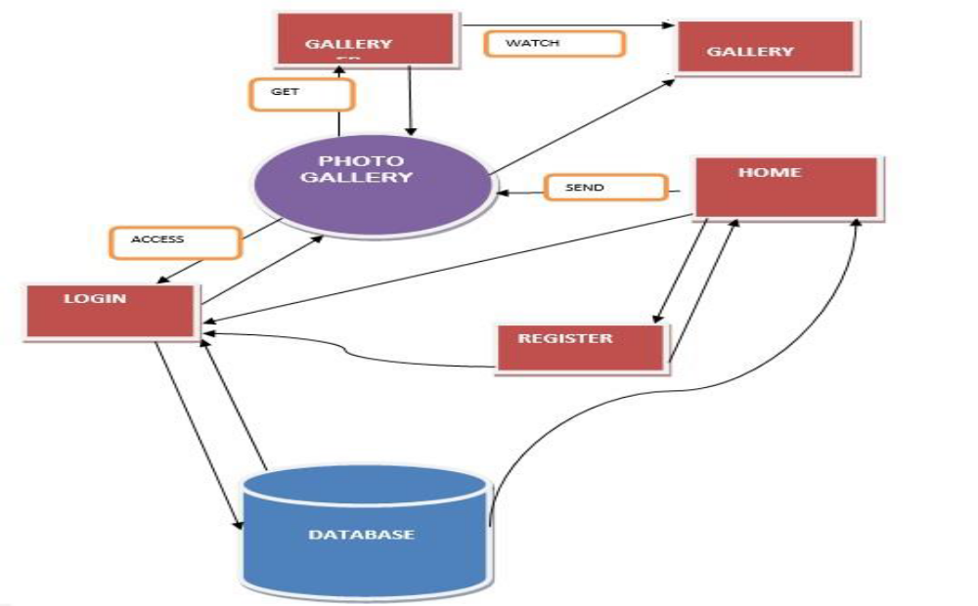
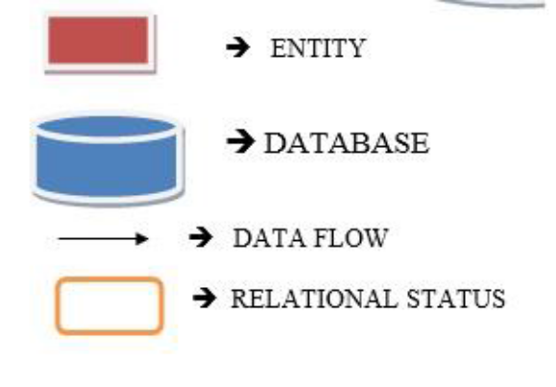
DFD

Slide 9
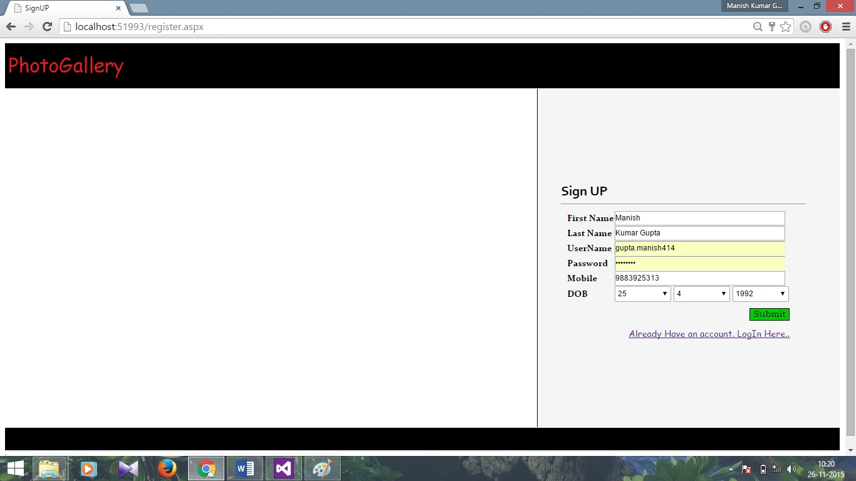
Screen Short (1)
Register Page

Slide 10
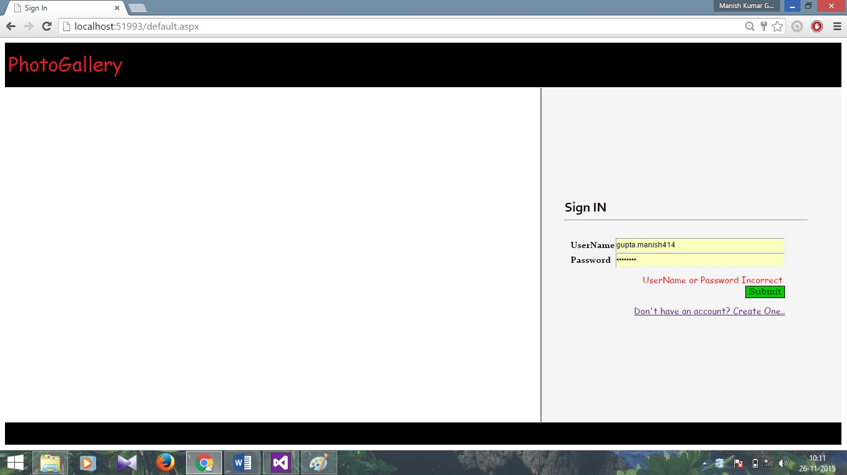
Screen Short (2)
Login Page

Slide 11
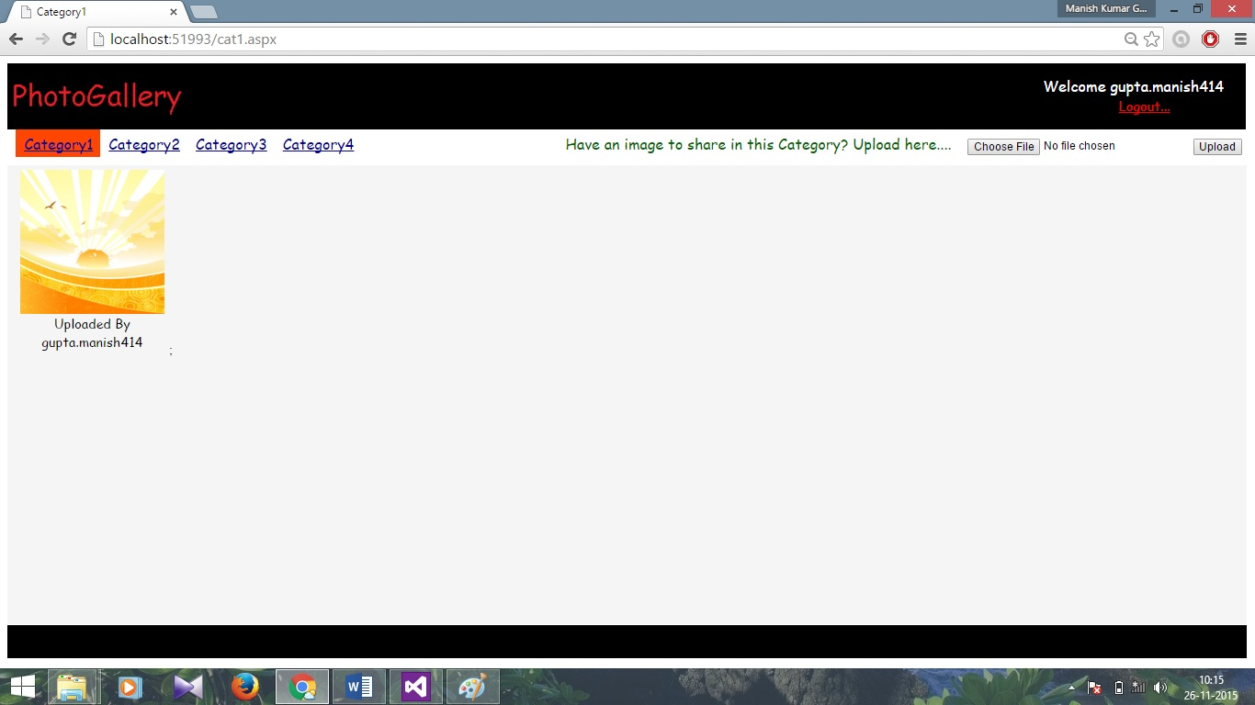
Screen Short (3)
Home Page

Slide 12
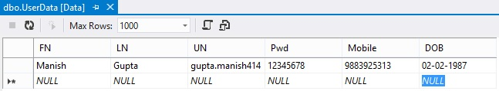
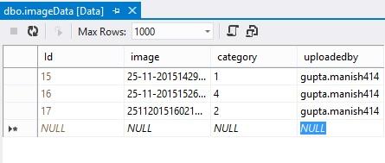
Screen Short (4)
User Login Database
Image Database

Slide 13
Conclusion & Future Work
The main aim of this work is to design the best website to see and upload different kinds of photos online in very sort time and user can also register and login to their own account.
Future work on this field will focus on the development of this website in a large scale and add some more convenient options for users.

Slide 14


